Slide 1

DAR ES SALAAM INSTITUTE OF TECHNOLOGY
DEPARTMENT OF ELCETRONICS AND TELECOMMUNICATION ENGINEERING
NTA LEVEL 8
PROJECT MINI 1 PRESENTATION
PROJECT TYPE: SYSTEM DESIGN AND PROBLEM SOLVING
CANDIDATE’S NAME: HENRICK E. DASTAN
ADMISSION NO: 200640725954
ACADEMIC YEAR: 2021/2022
DECEMBER 2022

Slide 2
PROJECT TITLE
SMART GATE OPENING AND AUTOMATIC RECEIPT/TICKET PAYMENT SYSTEM AT MAGUFULI MBEZI LOUIS BUS TERMINAL

Slide 3
PROJECT OVERVIEW
Introduction
Problem statement
Objective
Methodology
Literature overview
Existing system
Proposed system
Conclusion

Slide 4
INTRODUCTION
Magufuli Mbezi louise bus terminal is one of the commercial facilities used as a bus station for travelling services. It not only enhance smooth and efficient movement of people but also spur economic growth. It also has a system of paying 300tsh for entrance for travelling, receiving or packaging anything.
This amount of money is used by the government as a tax revenue collection fee accordingly to the amount of people entering the terminal for various activities.

Slide 5
PROBLEM STATEMENT
The amount of revenue collected manually by revenue supervisors is not a pleasing practice in reaching government’s collection target.
Also, the congestion of people during payment causes discomfort to many others while entering the terminal.

Slide 6
OBJECTIVES
MAIN OBJECTIVE
The main objective of this project is to design an automatic payment system which accepts coins and prints a receipt/ticket and opens/close the gate automatically.
SPECIFIC OBJECTIVE
To establish design specification of the system.
To design the power supply unit.
To interface the coin detector with control unit.
To interface of display unit with control unit
To design the interface of receipt printer unit and database system through communication module with microcontroller
To design the gate opening and closing system
To implementation by testing and building a prototype.

Slide 7
METHODOLOGY
LITERATURE REVIEW
In literature review, different sources of information based on principles of operations, features of the existing system have been revised.
DATA COLLECTION
Data collection is the process of gathering and measuring information on variables of interest in an established system fashion that enables one to answer stated research question, test hypothesis and evaluate the outcomes.
DATA ANALYSIS
Is based on the data collected that involves both qualitative analysis and quantitative analysis.
CIRCUIT DESIGN AND SIMULATION
This is the process of making the circuit based on the specifications of the components and the imitation of the operation of the real-world process of the circuit.
PROTOTYPE BUILDING AND TESTING
A prototype will be designed to test the circuit after simulation using appropriate software.
REPORT WRITING

Slide 8
LITERATURE REVIEW
Some of the technologies related to the proposed system which are advanced but lather more challenging;
Smart Card Technology; Electronic contactless smartcards are more durable, hard plastic cards and have become common at many fee collection agencies. For customers, smartcards have advantage over other system, but successful implementation can be challenging.
Smartphone Fee Collection: Smartphone payment offers an increase in customer convenience over paper or smartcard payment as well as potential operational savings. Smartphone payments eliminate the need for customers to buy and carry a separate card, may reduce delay in fee payment by reducing the use of cash.

Slide 9
Literature review cont…
Fare Collection System at DART (Dar as Salaam Rapid Transit) Stations
-DART this is the bus rapid transit system At Dar as Salaam Tanzania that began its operation in May 2016. With the objective of to increase the level of mobility of majority of residents enhancing their participation in a wide range of activities, it is a bus-based mass transit system which will operate on exclusive lanes, using high-capacity buses that’s can carry more than 140 passengers.
-This system include the two methods which are Selling Tickets and By using RFID Smartcards

Slide 10
LITERATURE REVIEW Cont…
Currently, in most bus stations, the system which is used to do payment is a local and manual. Also, the passage gates are operated by security guards.
The existing system involve a supervisor on which he/she collect the fee from the bus terminal users in order to allow them to enter. The gates are opened manually by security guards in letting people in, for those who have paid the entrance revenue.
Hence, fraud can be committed or conducted due to poor supervision of government collected revenue.

Slide 11
BLOCK DIAGRAM OF THE EXISTING SYSTEM
.
REVENUE COLLECTOR
COIN PAYMENT
RECEIVE RECEIPT/TICKET
GATE PASS

Slide 12
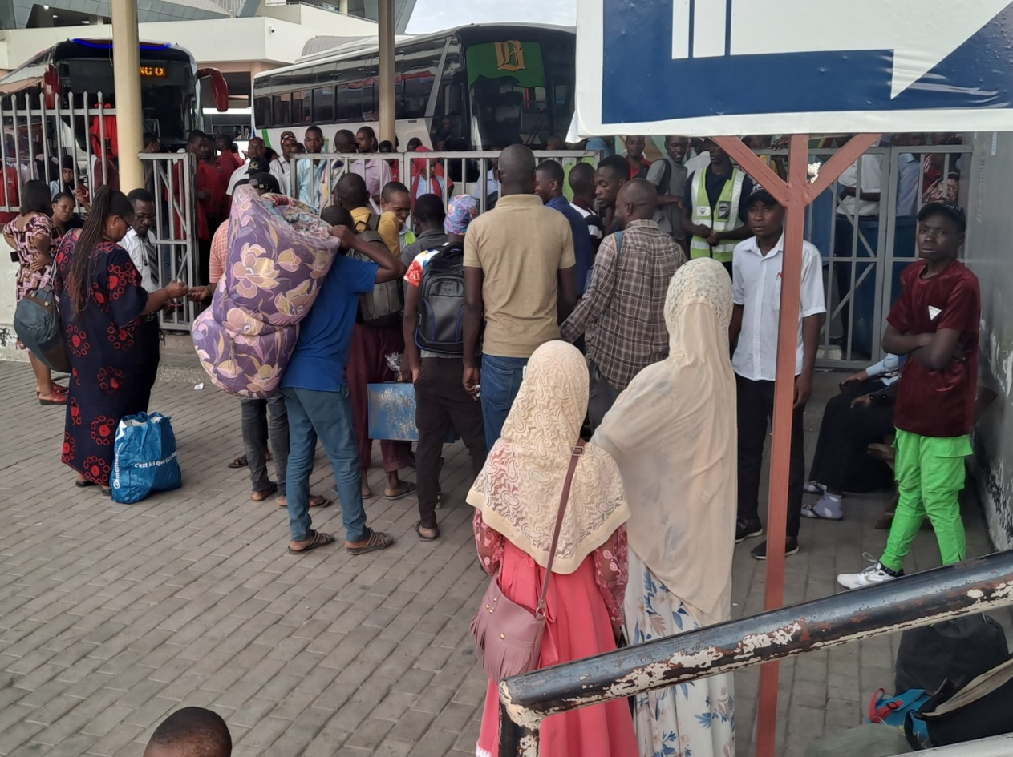
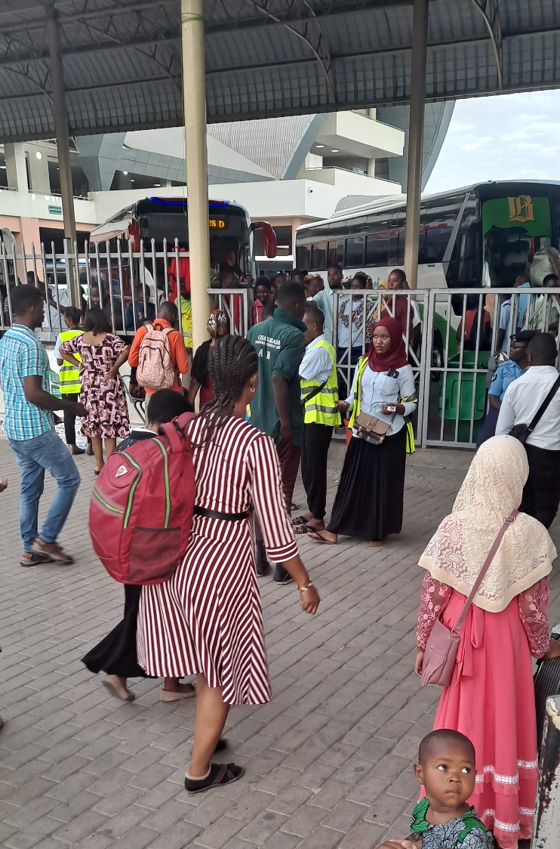
Existing system cont…

Slide 13
DRAWBACKS OF EXISTING SYSTEM
Poor government revenue collection
It’s not reliable since it is manually operated by employed men.
Does not have reliable security for the money collected because employed men who stay with money can easily lose money or tempted to steal the money collected.
Jam during paying for receipts which can lead to failure in reaching on time for the bus.
Congestion caused by human interaction may lead to health diseases

Slide 14
PROPOSED SYSTEM
The system design will be implementation of an electronics system that will be able to accept coin only if it’s a genuine one. The coin will pass to the storage container and the control unit would give an output signal in order to print automatically a receipt/ticket that will be used as a passage signal in opening the gate. Hence, the gate will open automatically and payment will be recorded to the database for further management issue.

Slide 15
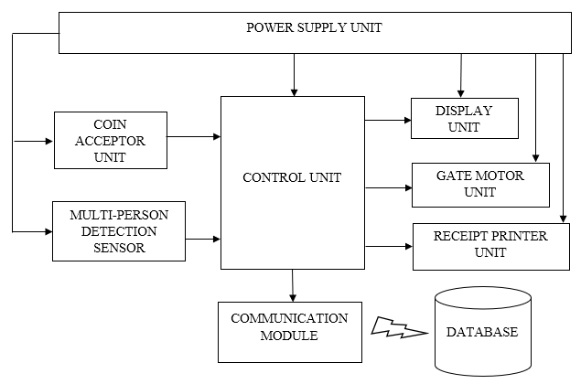
PROPOSED SYSTEM BLOCK DIAGRAM

Slide 16
Proposed system Cont.....
The Significances of the Proposed System;
It will reduce the work done by the operators since the system will be automated
The system is easy to control
Reliable
Operated at low cost
Ensures a precise secured collection of revenue on real life basis

Slide 17
SCOPE OF THE PROJECT
The coin machine will not serve users with note only coins can be served.
The system will not control the changing system once someone puts 500shs and needs only 1 ticket, unless external supervisor is involved.
Database will only record number of tickets printed for revenue calculation.

Slide 18
DATA COLLECTION
Data collection is collection of data to be used for the designing of the proposed system.
TYPE OF DATA COLLECTION:
Primary data will be obtained through the use questionnaires to the intended users and interview questions to the Ubungo Municipal Council officers at Mbezi Bus terminal.
Technical data on is based on different components which may be used on the project before choosing the best out of it.

Slide 19
Data collection cont…. Below are Primary data obtained
S/N | QUESTIONS | RESPONSE
1 | Which system do you use for collecting government revenue at Mbezi louise Bus terminal?
2 | How many employees do you need to accomplish the task?
3 | How do you see the limitation of your system of collecting revenue?
4 | Are you aware of the risks using employees to accept money and put on their pockets?
5 | How do know someone hasn’t committed any fraud or stole the revenue collected?
6 | What do you think about the system proposed for collecting revenue and store information on your database?

Slide 20
Cont….
S/N | QUESTIONS | RESPONSE OF USERS |  | % VALUATION OF THE EXISTING PROBLEM
 |  | YES | NO
1 | Do you save time from the current system? | 1 | 14 | 93.33%
2 | Are you satisfied with the current service provided? | 3 | 12 | 80%
3 | Have you ever faced being stolen your property while paying for receipt/ticket? | 8 | 7 | 53.33%
4 | Do you think an automatic payment system and receipt printing will be helpful? | 15 | 0 | 100%
S/N | QUESTIONS | RESPONSE OF CASHIER |  | % VALUATION OF THE EXISTING PROBLEM
 |  | YES | NO
1 | Is the system more challenging to you? | 7 | 2 | 77.77%
2 | Do people complain of the current payment method? | 6 | 3 | 66.67%

Slide 21
Cont…

Slide 22
REFERENCE
[1] G. M. Gebru, T. T. Bezabih “Coin Based Vending Machine”, International Journal of computer and information technology, vol. 4, pp. 207-302, May 2015
[2] E. K. Roggen, Electronification of payments in Europe, Monthly Bulletin, May 2003
[3] D. Wayhal, M. Giri, “Transit Fare Collection Technology ”, International Journal of Advance Research, IJOAR .org, 2013, Online, pp.65-73

Slide 23
THANK YOU…

